Slide 1
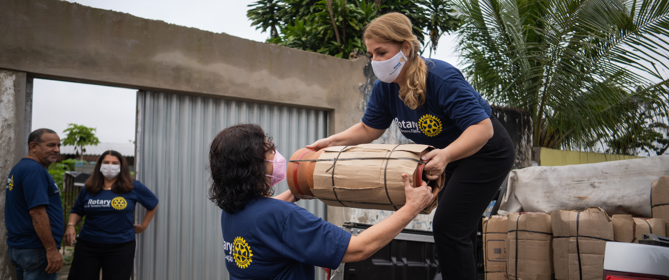
DOING GOOD IN THE WORLD
with The Rotary Foundation

Slide 2
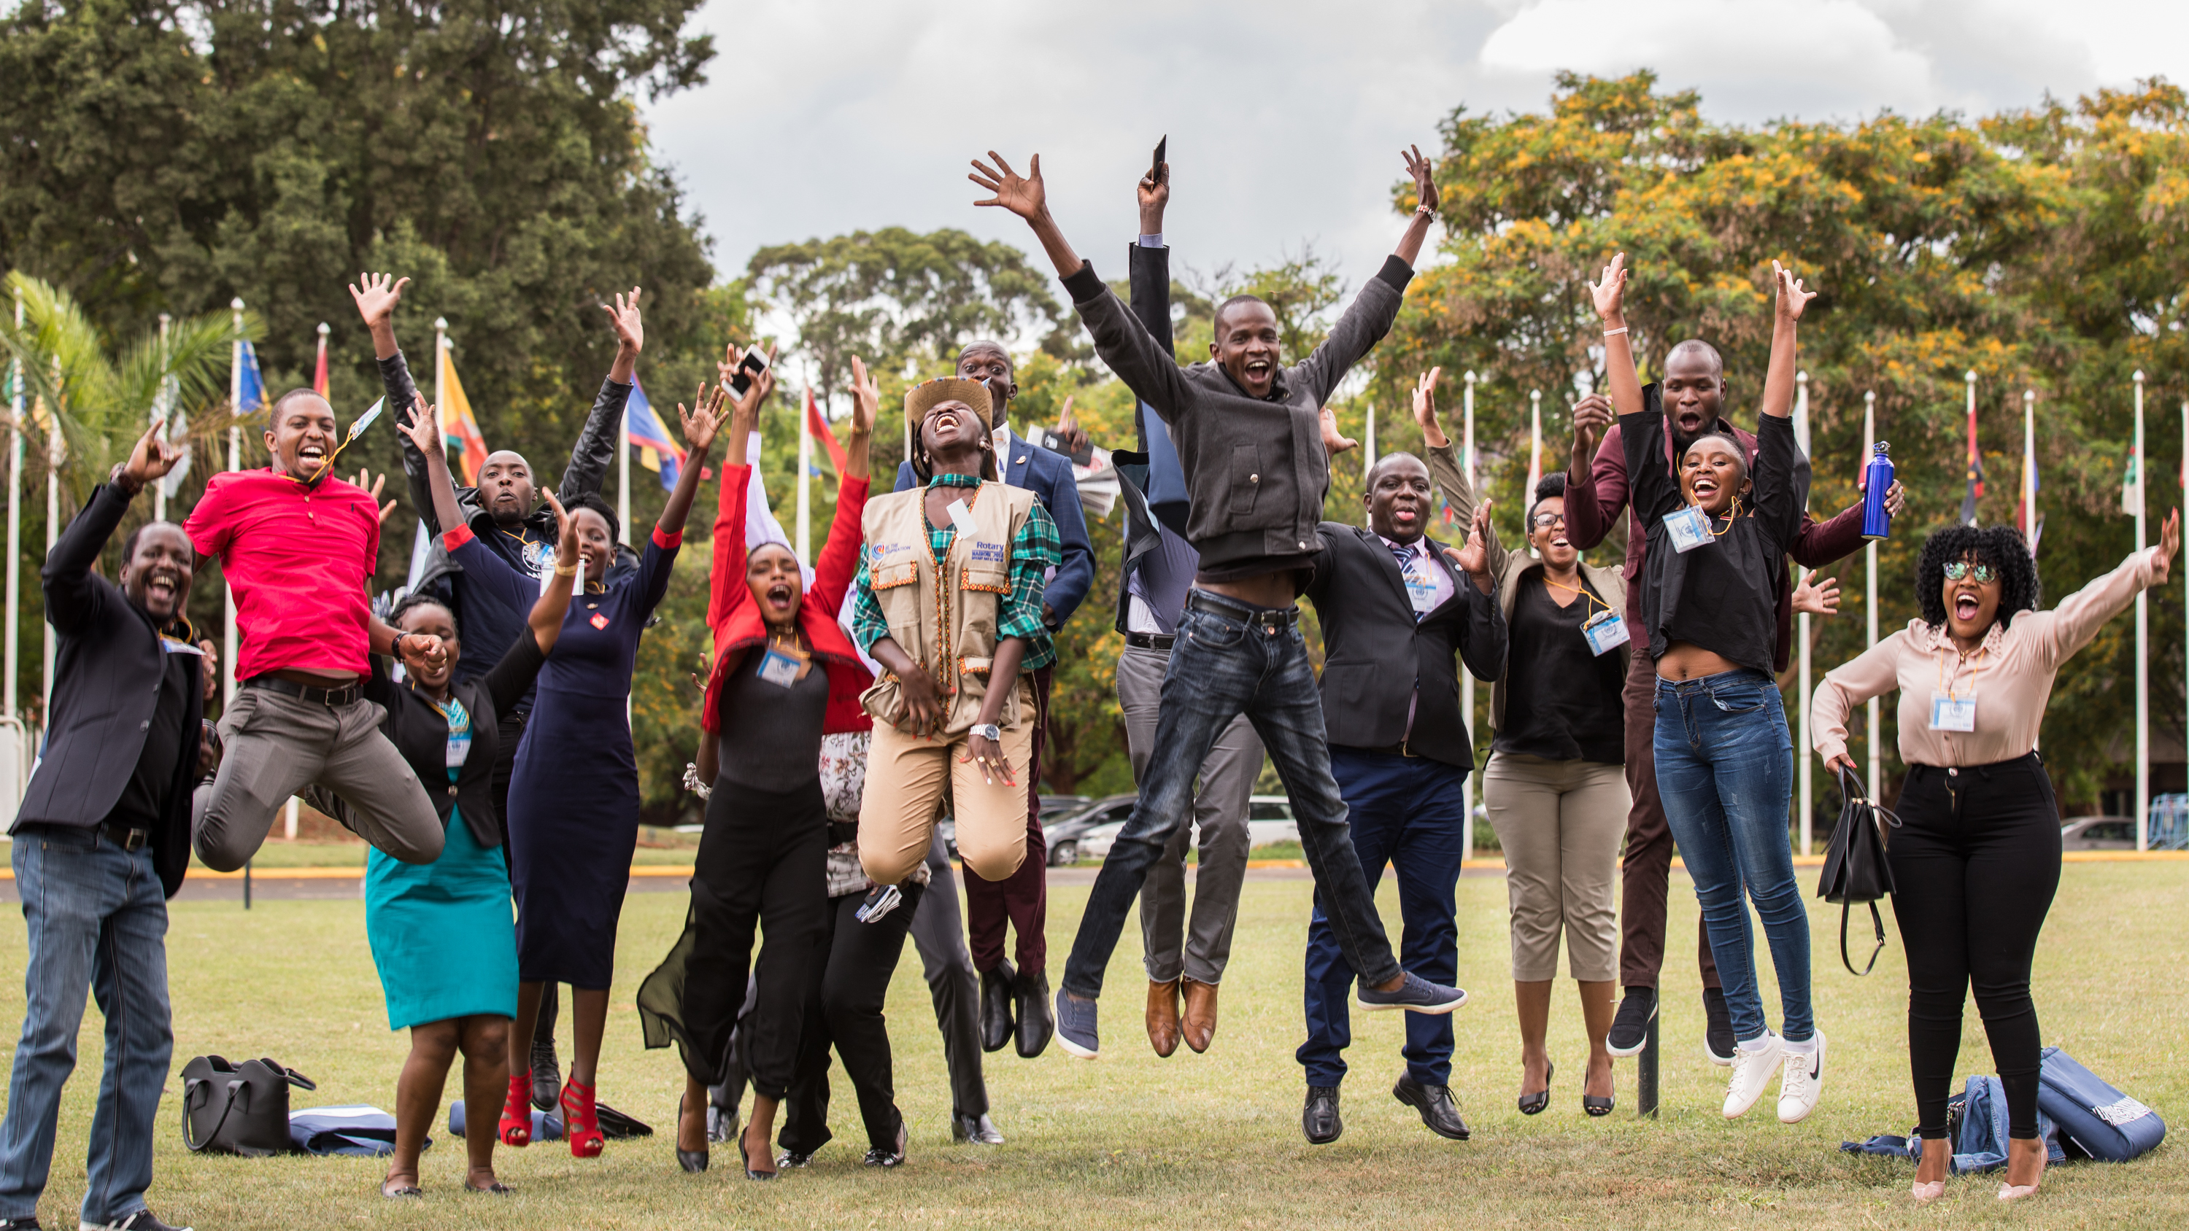

The Rotary Foundation helps Rotary members to
advance world understanding, goodwill, and peace by
improving health, providing quality education, improving the environment, and alleviating poverty.
Notes:
The Rotary Foundation’s mission is to advance world understanding, goodwill, and peace by improving health, providing quality education, improving the environment, and alleviating poverty.
We hope members see themselves in this mission, specifically that the Foundation was created to help members do good in the world.

Slide 3
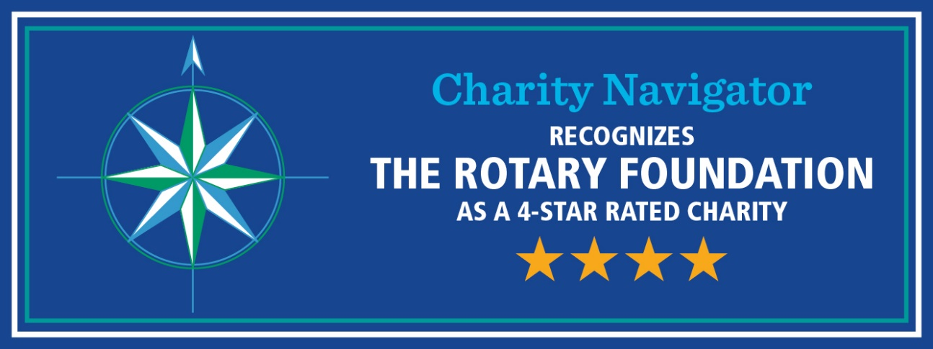
88% of funds are spent on program awards and operations
We’ve earned 15 consecutive four-star ratings from Charity Navigator
Outstanding performance
We’re an organization you can support with confidence.
The Rotary Foundation continues to far exceed the standards set by independent charity-rating services like Charity Navigator.
Notes:
Our Foundation is carefully overseen by your fellow Rotary Members, the Trustees of The Rotary Foundation. They ensure that your donations are invested well and spent wisely so they’ll do good in the world.
Our members’ generosity and Rotary’s work haven’t gone unrecognized. For the 15th consecutive year, The Rotary Foundation has received the highest rating — four stars — from Charity Navigator, an independent evaluator of charities in the U.S., for demonstrating strong financial health and commitment to accountability and transparency.
The rating reflects Charity Navigator's assessment of how the Foundation uses donations, sustains its programs and services, and practices good governance and openness.

Slide 4
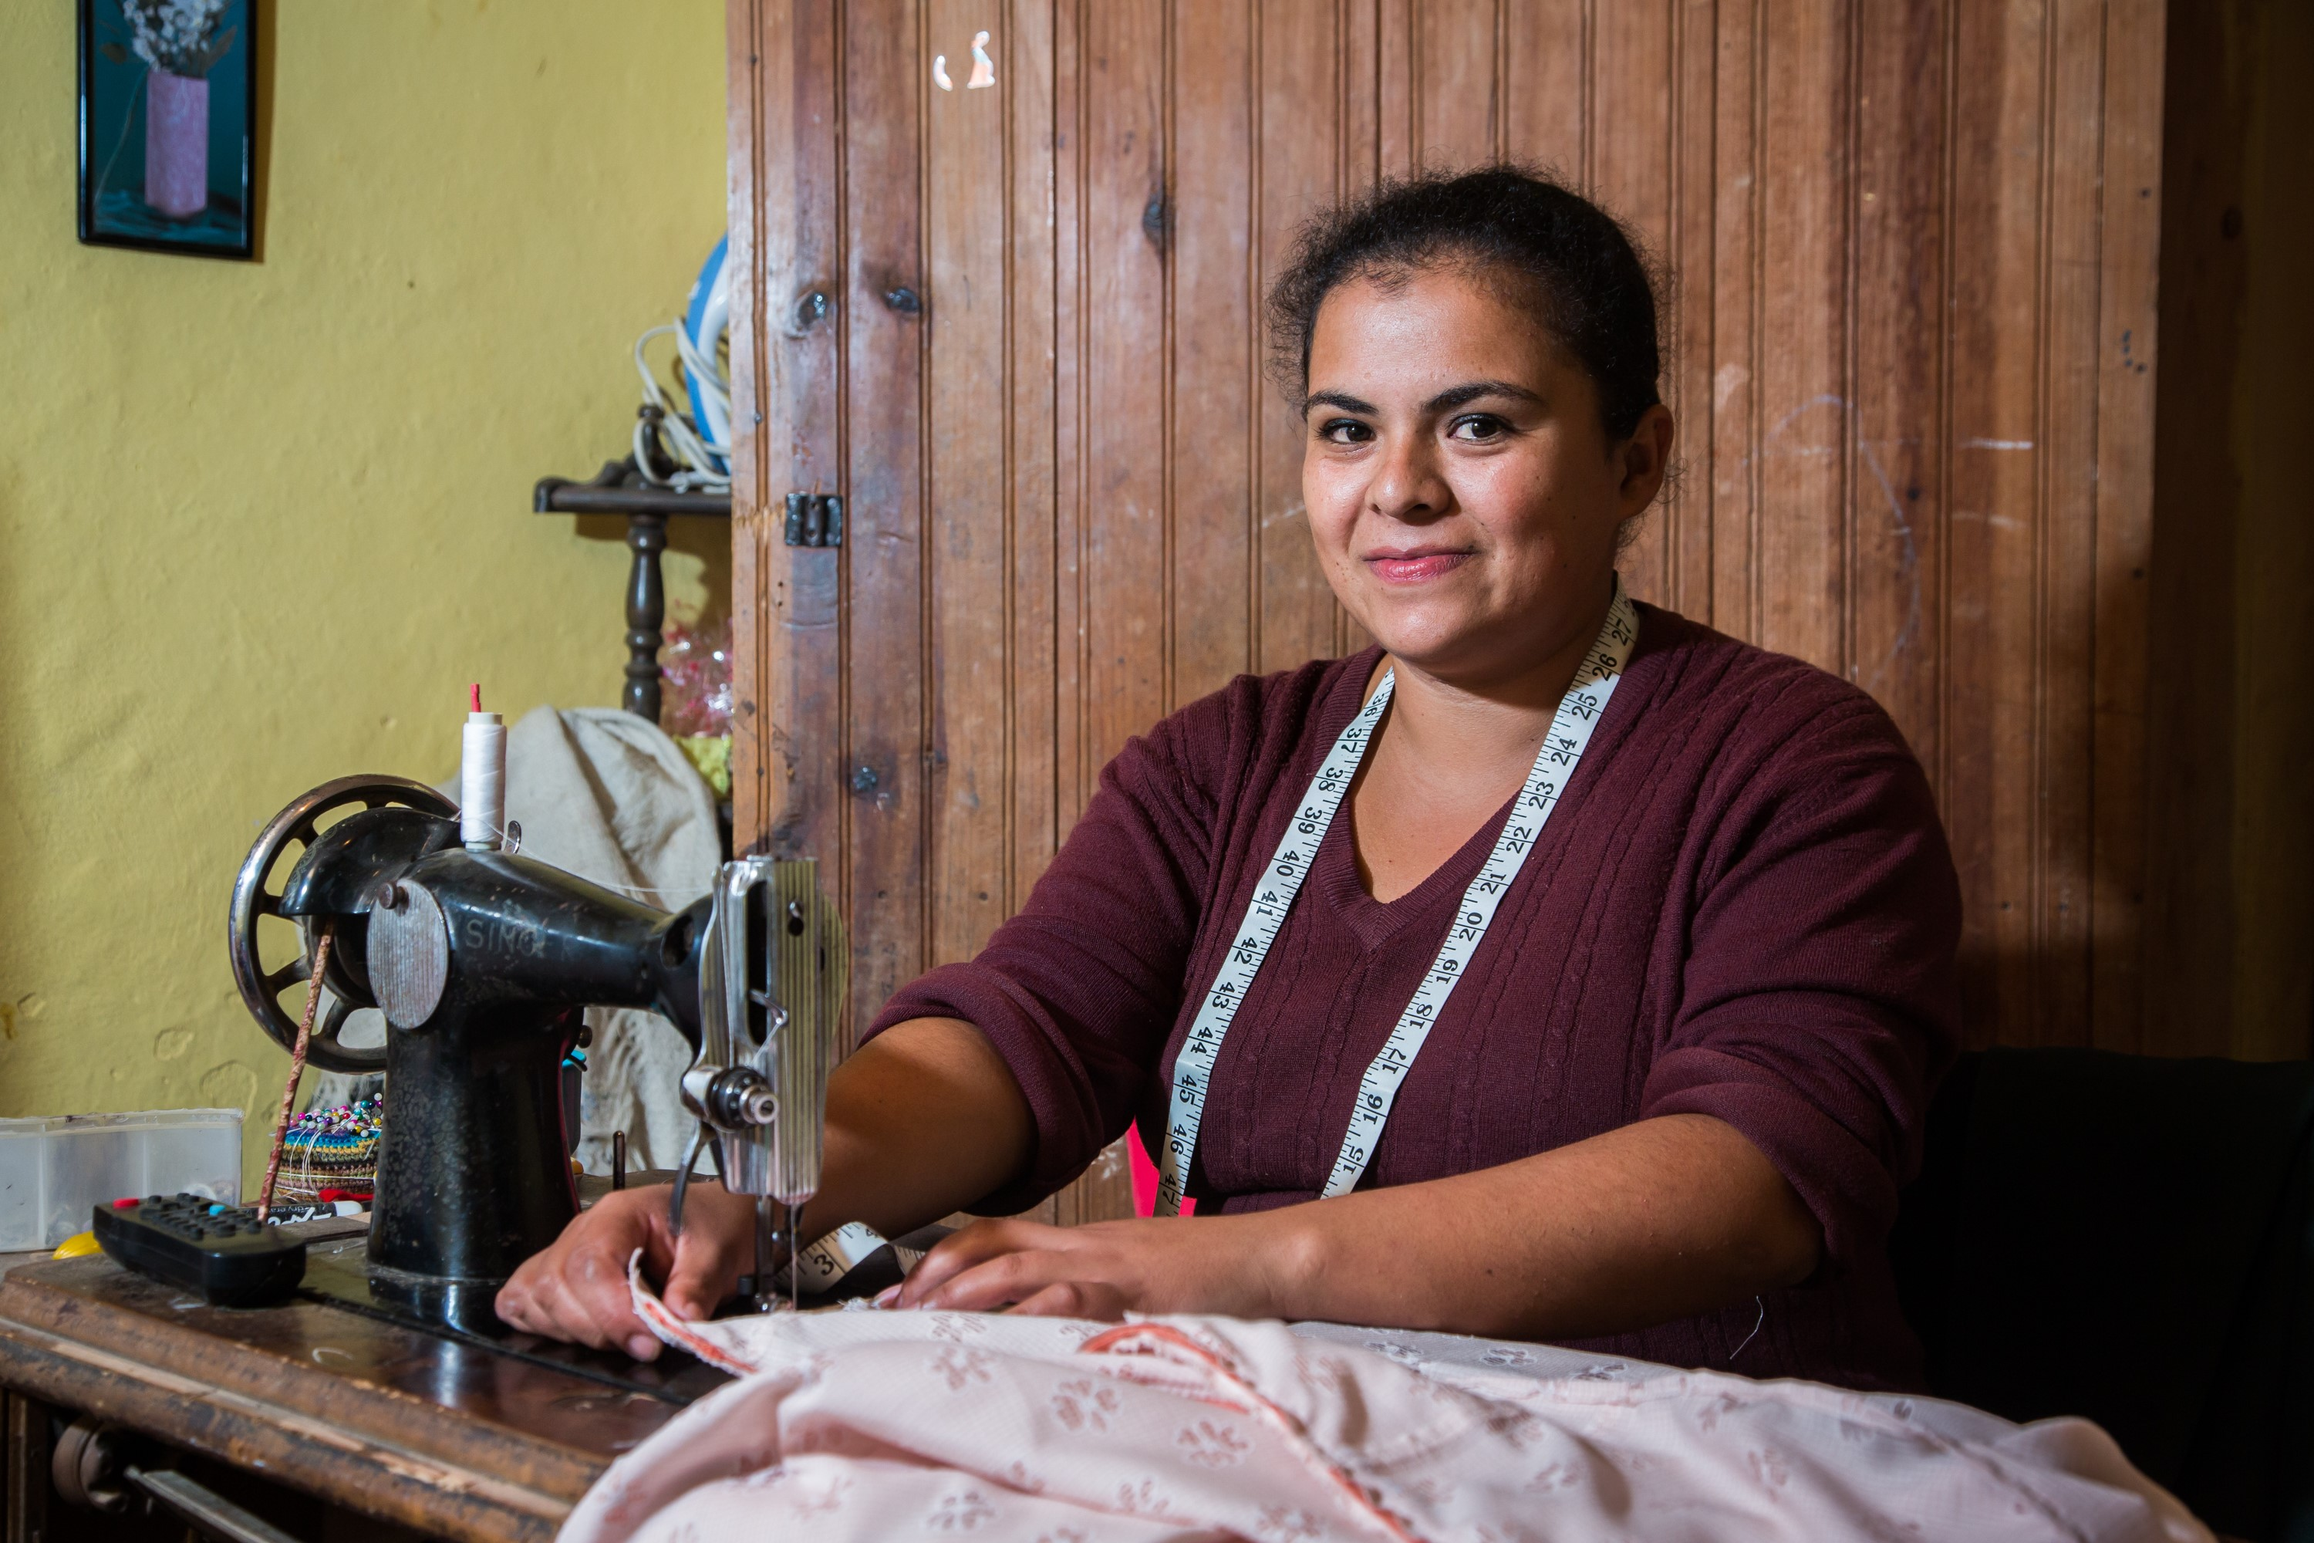

THE ANNUAL FUND
Notes:
Our Foundation’s Annual Fund helps pay for local and international grant projects. Contributions to our Annual Fund make our humanitarian impact possible.
When you give to the Annual Fund, you help people like Chih-Fan Weng, a farmer, harvests cabbage in Taiwan. Farmers in the villages of Sikikun and Pyanan have long grown cabbage, using pesticides and turning the soil over each year, and these conventional farming practices were endangering the water supply for Yilan County’s 450,000 residents. Rotary members from District 3490, in partnership with National Ilan University and local businesses, helped the community adopt more sustainable farming practices as well as higher-yield crops like chestnuts and truffles. Rotary members also support training in e-commerce and marketing to help the farmers sell their harvest. Since 2021, 18 landowners in Datong Township have increased their revenues 15-fold through the project , which has resulted in agricultural diversification, better educational opportunities, more free time, and a cleaner and healthier environment. The project is supported by Rotary Foundation global grant #2010776. Yilan, Taiwan. 19 December 2022.
Giving to the Annual Fund supports Rotary member led projects like these — projects that are created at the local level, that are developed to meet the community’s needs, and that foster international friendship. Through a single gift, you can help people like Chih-Fan Weng provide a better life for their communities.

Slide 5
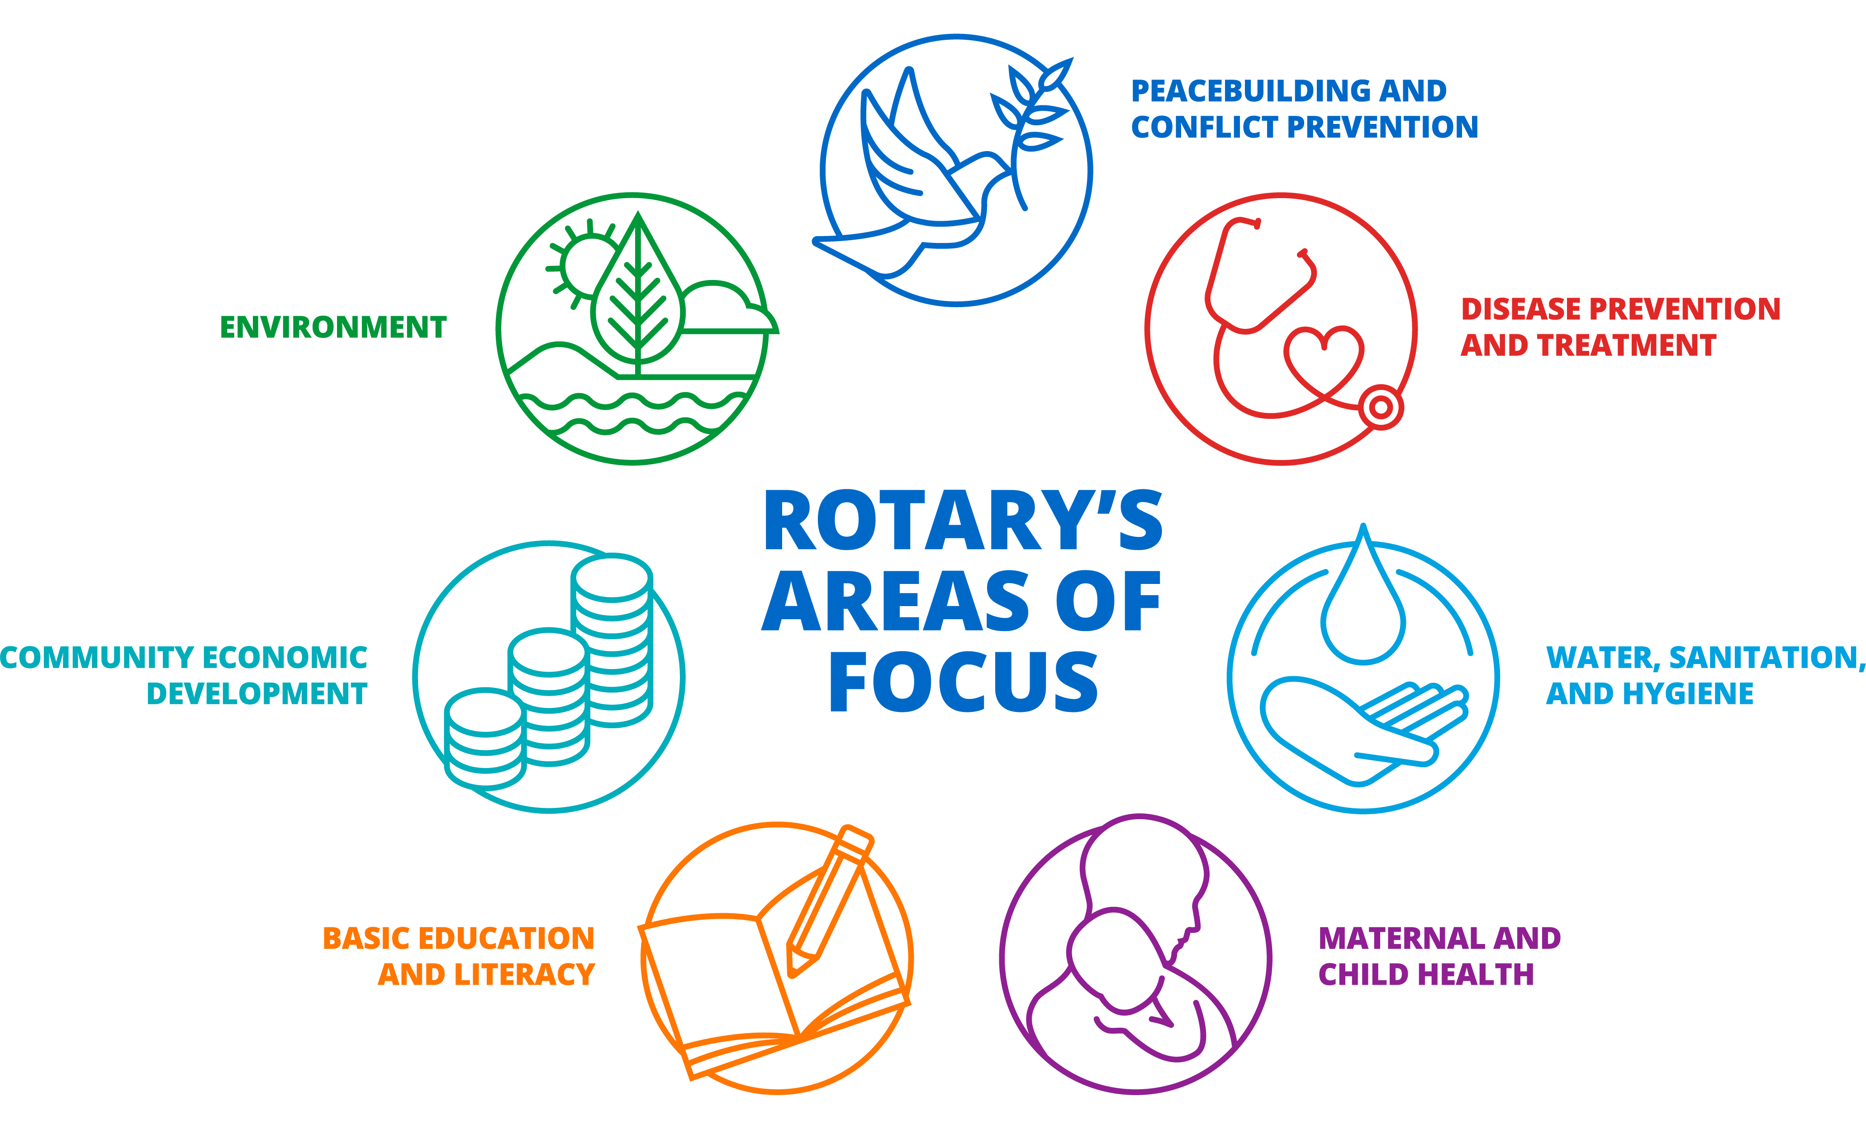

ANNUAL FUND - areas of focus
170
$59.4
189
$15.3
57
101
$8.9
Notes:
Our Foundation is dedicated to causes — or areas of focus — that build international relationships, improve lives, and promote a more peaceful world. Which of these causes resonates with you? What are you passionate about?
The Foundation can help you turn your passion for a cause into action and lasting change. Rotarians are encouraged to lead efforts in these areas, and The Rotary Foundation is here to support those efforts with grants.
In fact, the very mission of our Foundation is to enable Rotarians to advance world understanding, goodwill, and peace by improving people’s health, supporting education, improving the environment, and alleviating poverty.

Slide 6
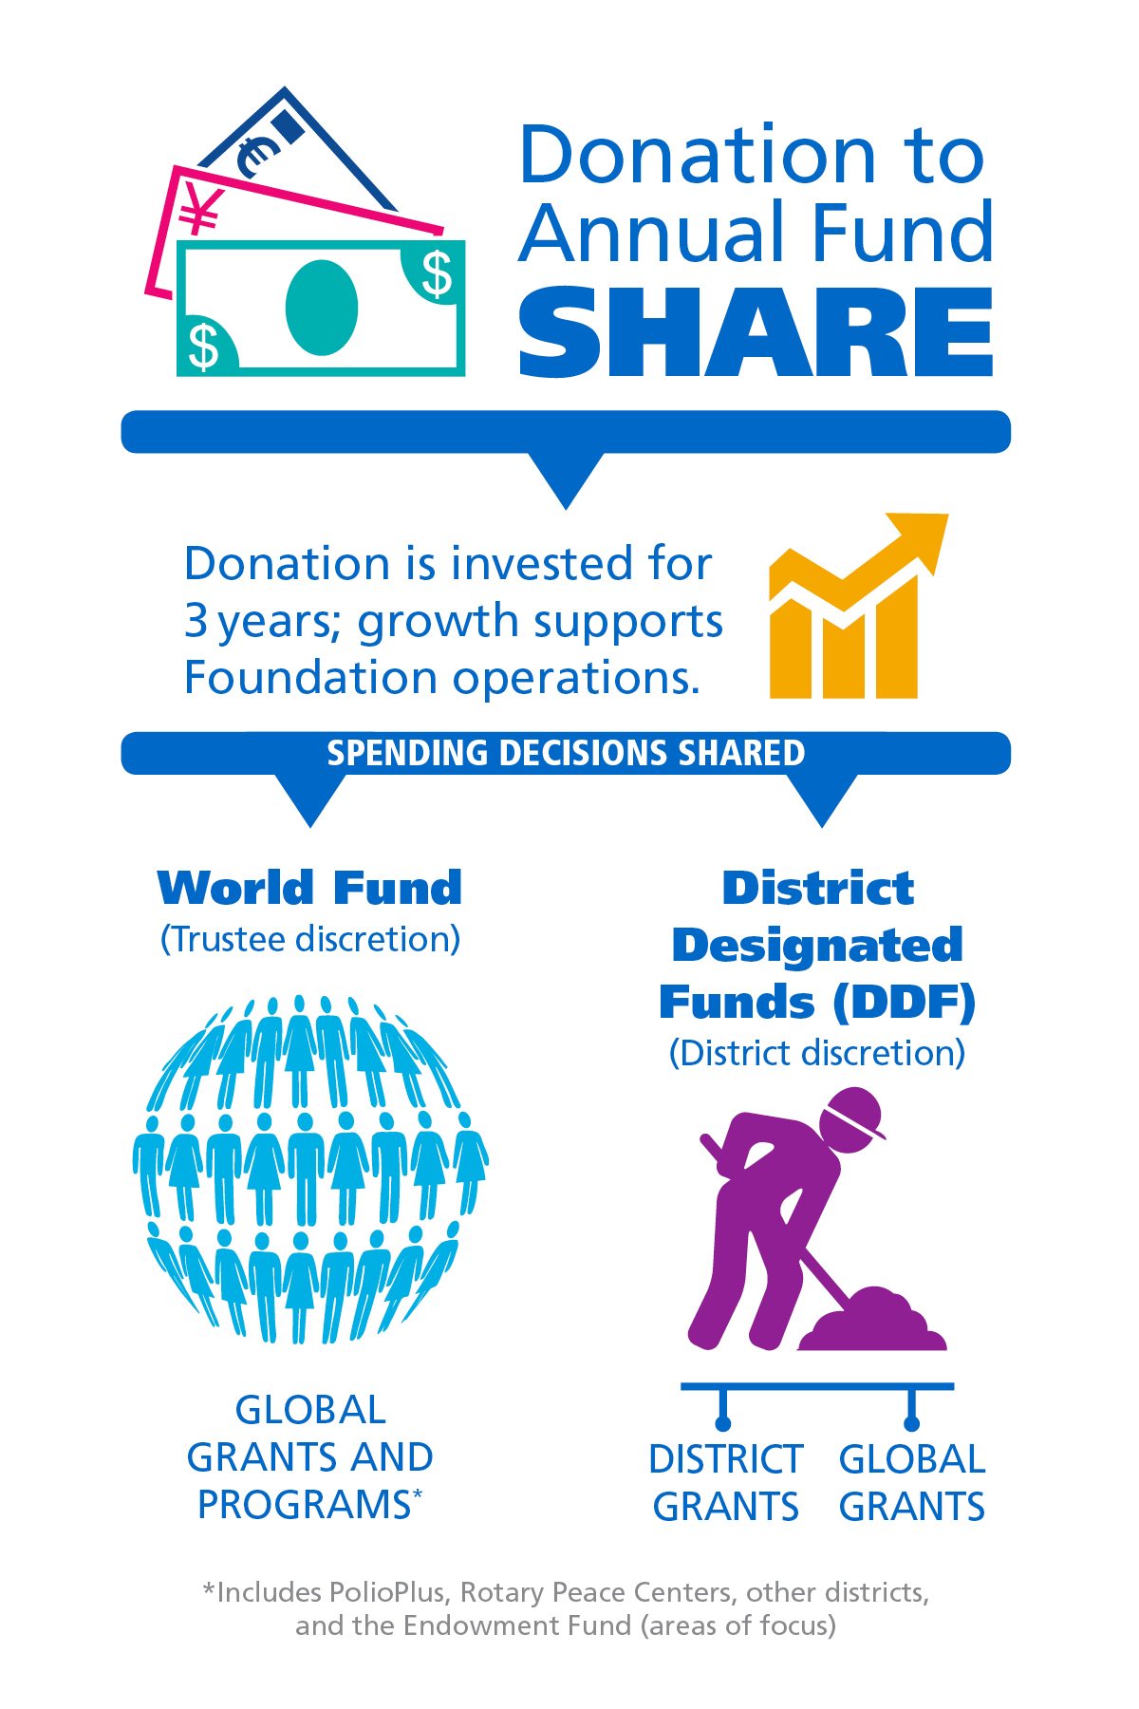
ANNUAL FUND -
SHARE
When you give to Annual Fund – SHARE, The Rotary Foundation transforms your gifts into service projects that change lives close to home and around the world.
Learn more at: https://my.rotary.org/en/annual-fund
Notes:
When donors are asked why they support the Annual Fund, many say it’s because you get something back when you give. When you contribute to the Annual Fund-SHARE, part of your gift becomes available for your district and its clubs to use however they want on Foundation programs.
[Consider giving the following explanation, depending on the audience.]
When you donate to the Annual Fund-SHARE:
For three years, your contribution is invested.
After three years, that money is made available to fund projects.
A portion goes into your district’s District Designated Funds (also known as DDF). Your district can use it to help fund local and international projects. It decides how to use the money.
A portion goes to the World Fund. This money is used for grants, grant matches, Foundation programs that are available to all Rotary districts, or aid where the Trustees determine it to be needed most.
Districts that use both district grants and global grants get the full impact of gifts made by their members.
How many of you have participated in a global grant?
The World Fund is the source of the Rotary funding for your global grants.
And how many of you have participated in a district grant?
Those grants, too, are possible because Rotarians in your district gave to the Annual Fund.
The funds we have access to this year come from contributions made three years ago. (For example, funds available in 2023-24 are from contributions made in 2020-21.) That’s why it’s so important for members to support the Foundation consistently.
For more information about the Annual Fund, go to my.rotary.org forward slash annual-fund.
**Note to presenter: 47.5% goes to World fund and 47.5% goes to DDF

Slide 7
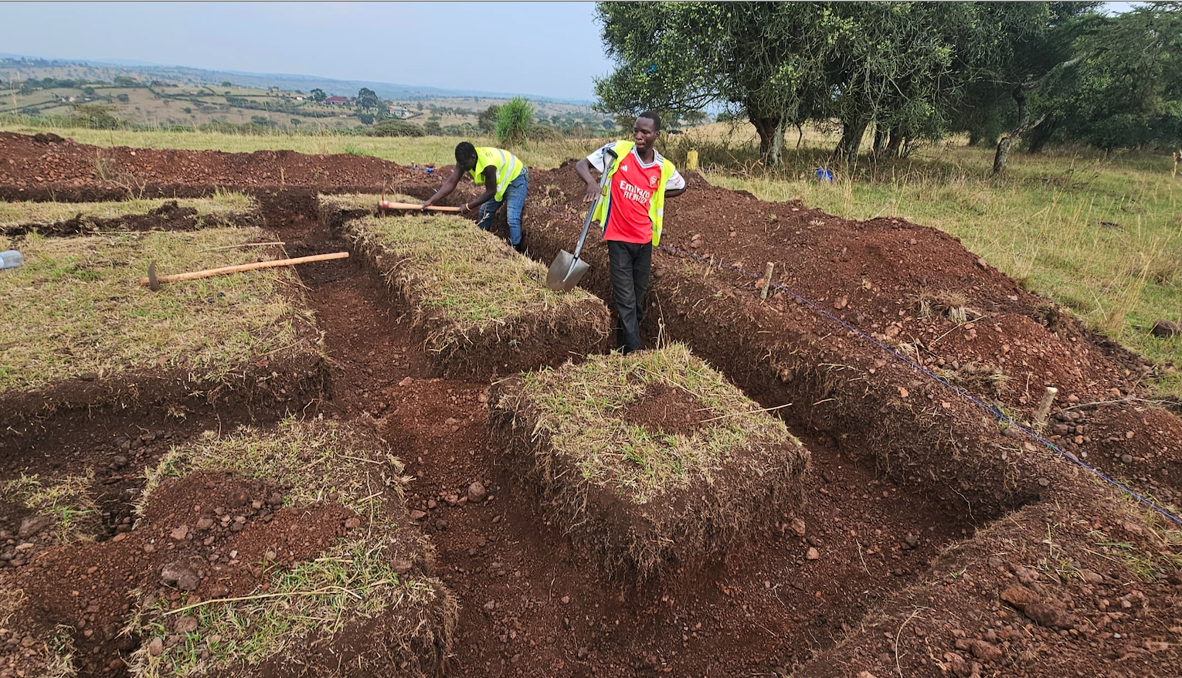
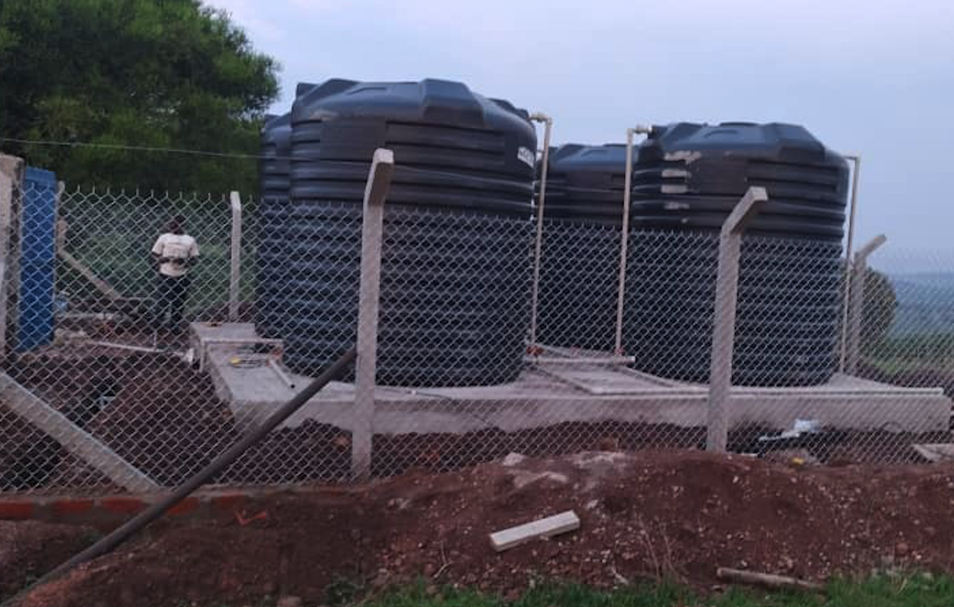
Global grants make a BIG impact
Drilling a well and building a water system in uganda
They drilled and built a water well. Then installed a water system delivering to a village that housed a hospital and school. The total cost was ~$90,000. The Rotary Club of Kona contributed $6,000.

Slide 8
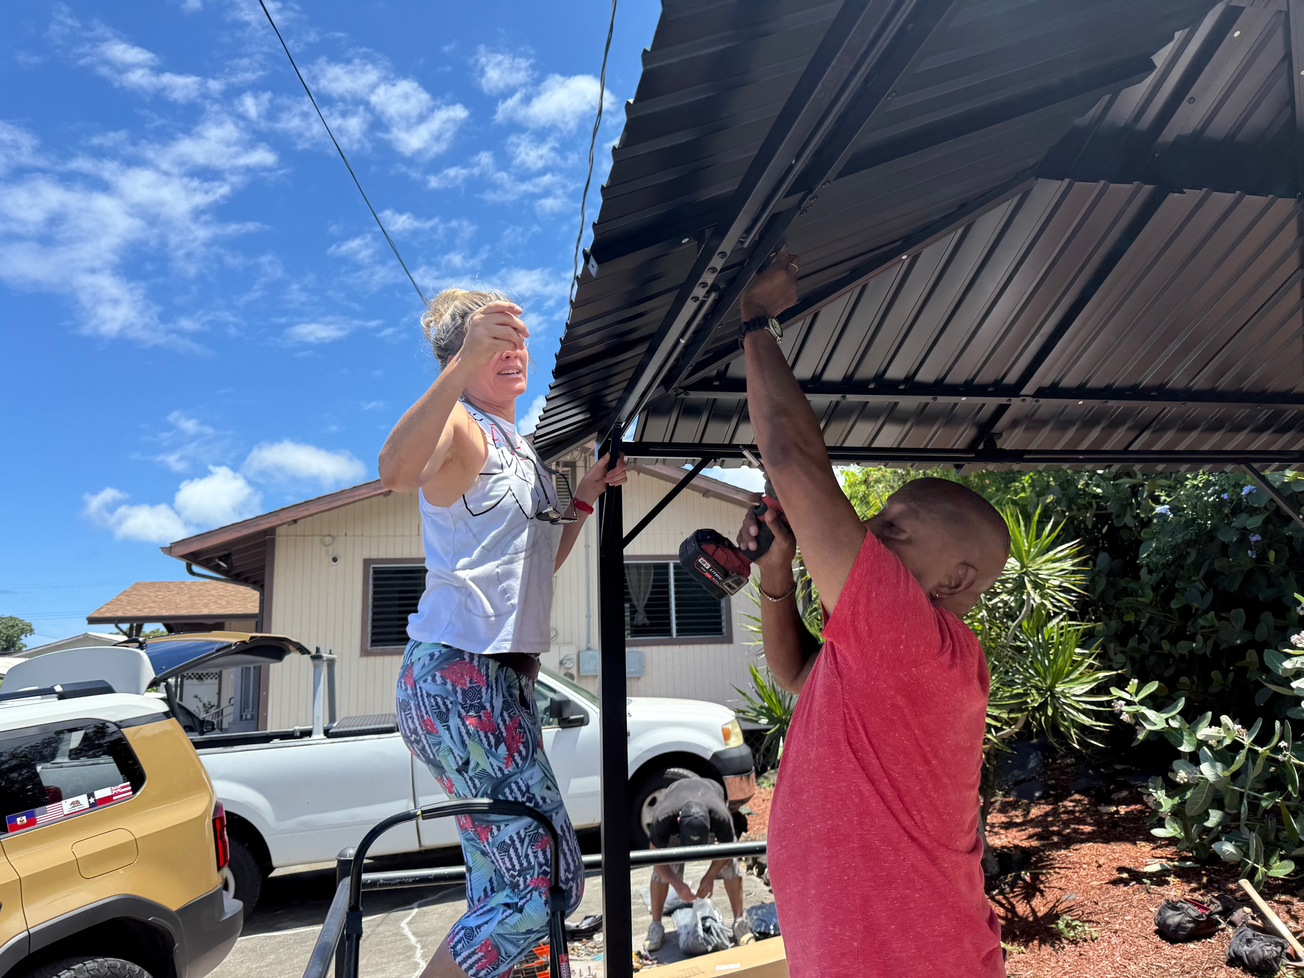
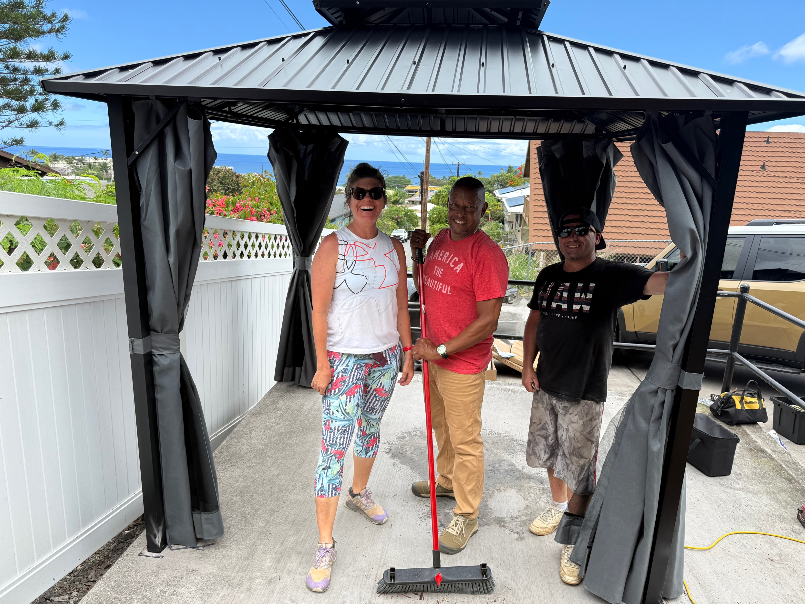
District grants meet local Needs
THE ROTARY CLUB OF KONA BUILDS GAZEBOS AT MENTAL HEALTH RESIDENCES IN KONA

Slide 9


Every rotarian, every year
Did you know that donors who gave $25-$99 contributed more than $5.4 million to the Foundation in 2022-23? When every Rotary member gives every year, it makes life-changing, sustainable projects possible.
Also in 2022-23:
$147 million was given to the Annual Fund.
34% of Rotarians donated to the Annual Fund.
81% of Rotary clubs supported the Annual Fund.
1,098 global grants were awarded.
Notes:
These projects we’ve just discussed were possible because Rotary members supported the Foundation and participated in Foundation grants.
Rotary has a fundraising initiative called Every Rotarian, Every Year. The goal is to increase both Annual Fund support and Rotary member engagement with the Foundation. How many of you have heard of Every Rotarian, Every Year?
The idea is that, if every Rotarian gave at least $25 to the Annual Fund yearly, what the Foundation could accomplish would multiply.
In 2022-23, we accomplished a lot:
Donors who gave $25-$99 contributed over $5.4 million to the Foundation.
Rotarians gave a little over $147 million to the Annual Fund.
34% of Rotarians supported the Annual Fund as individual donors.
81% of Rotary clubs worldwide supported the Annual Fund.
The Foundation awarded 1,098 global grants.
With a third of Rotarians worldwide donating to the Annual Fund and becoming eligible for EREY, we’ve achieved a lot and improved the lives of many. Can you imagine how many more lives could be changed through grant projects if we encouraged even more members to contribute at least $25 to the Annual Fund every year?

Slide 10
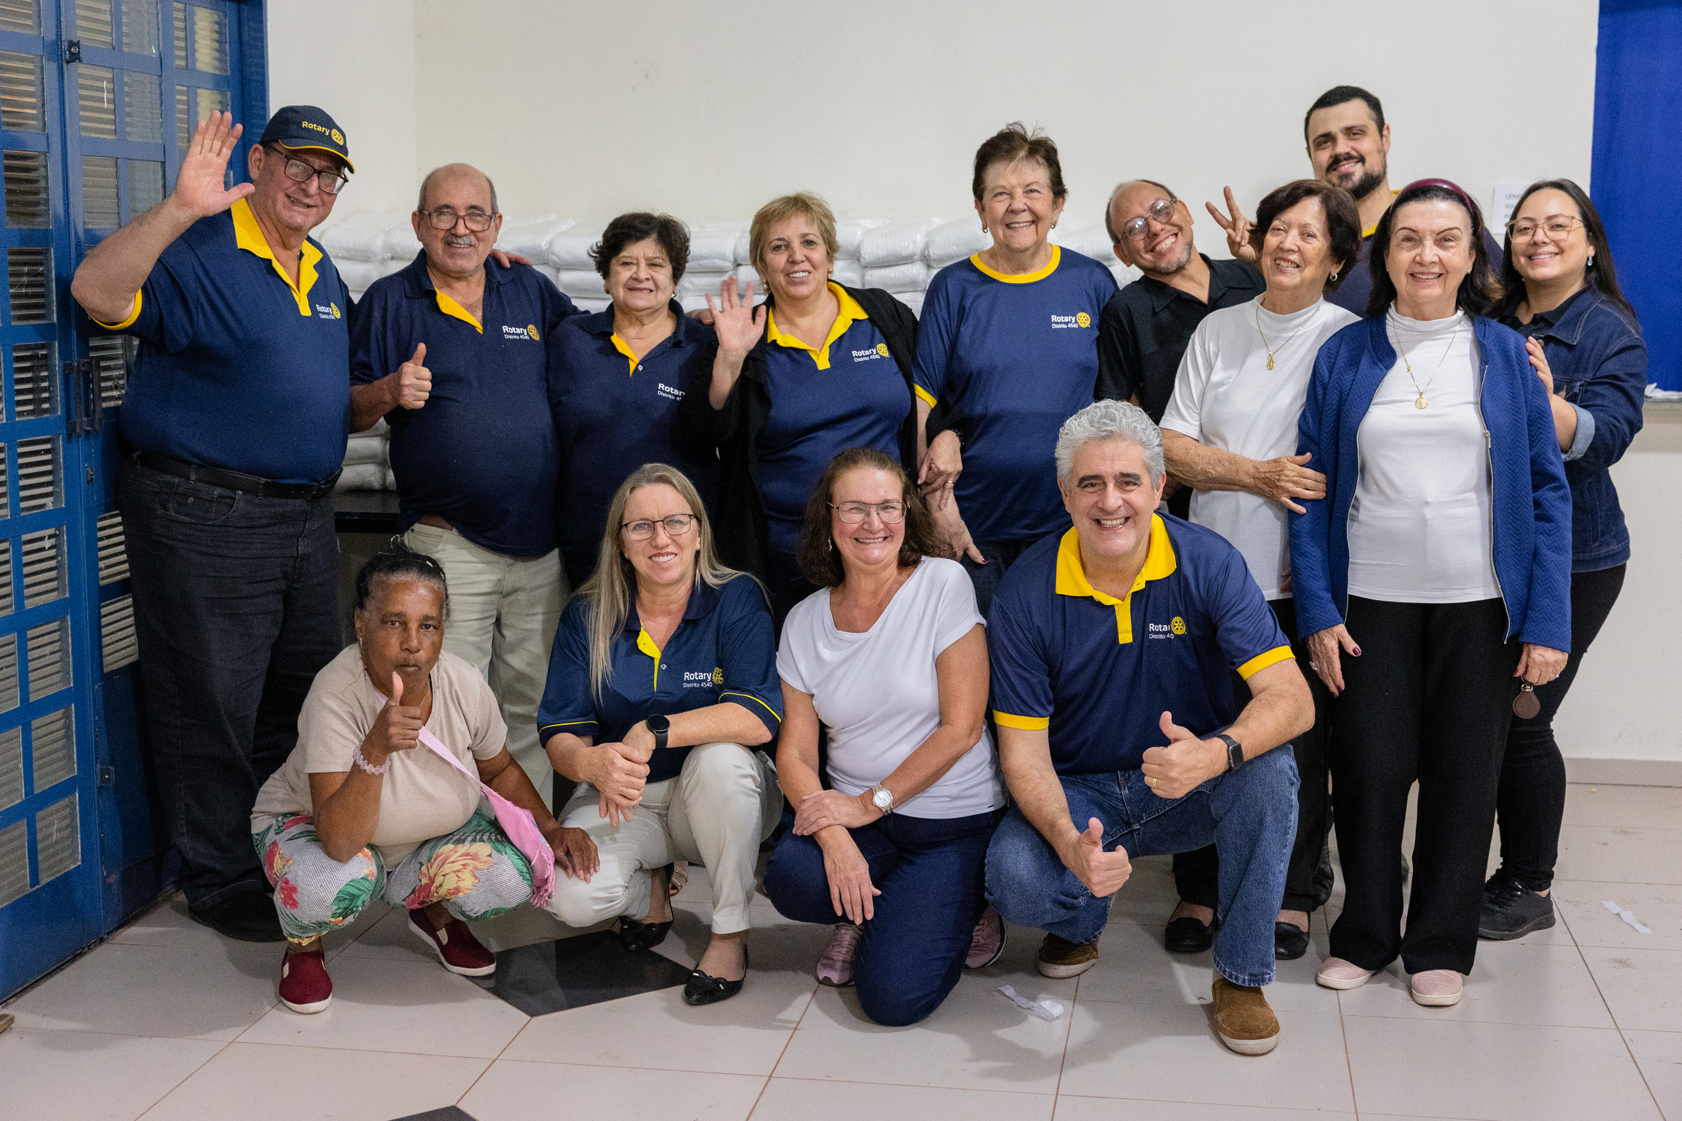
Individual and club recognition

Slide 11
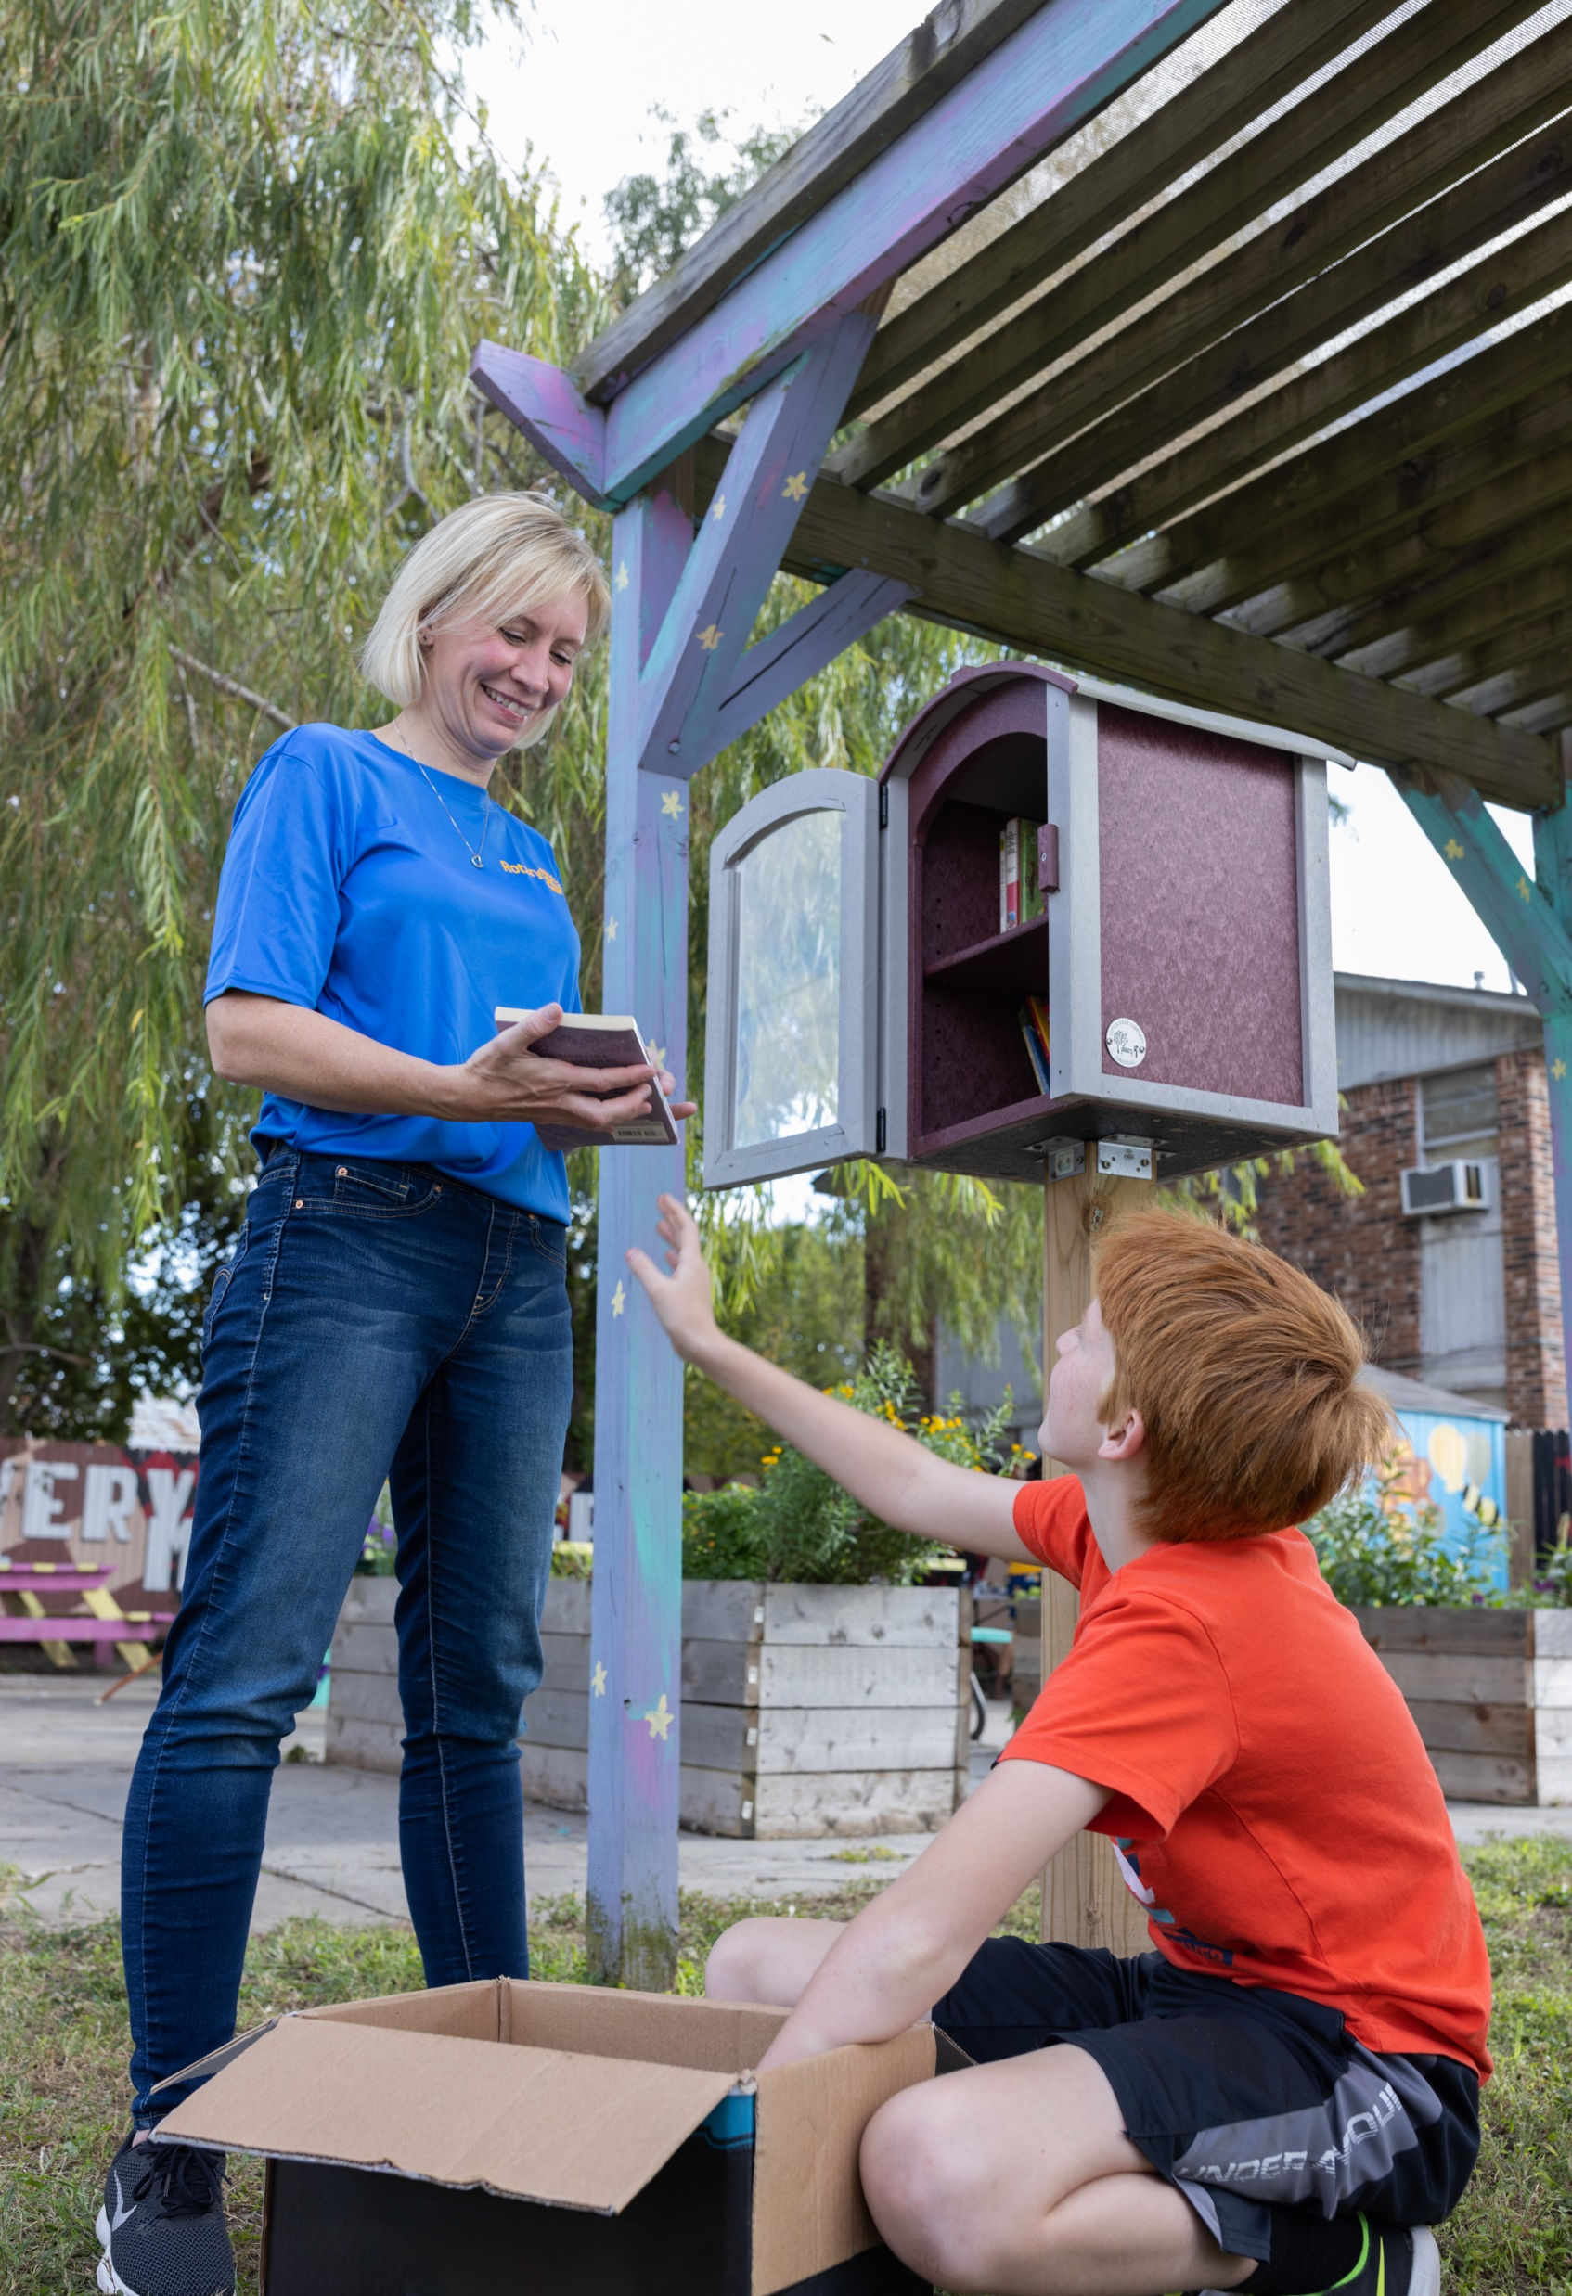
Sustaining our work
Sustaining members
A Rotary Foundation Sustaining Member is someone who gives US$100 or more to the Annual Fund.
Notes:
Without sustained support of the Annual Fund, the programs of The Rotary Foundation cannot happen. But with contributions of $100 from every member every year, we could nearly double our efforts to help people in need.
Someone who contributes $100 or more to the Annual Fund is a Rotary Foundation Sustaining Member.
When you donate to Rotary, you can be assured that your gift will be used to its fullest by Rotary Members around the world.

Slide 12
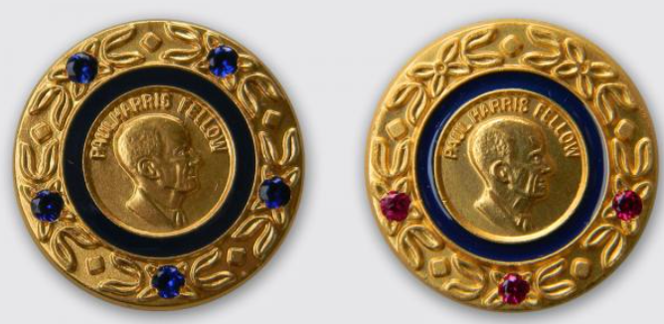
Paul harris Fellows
Paul harris Fellow recognition
Donors become Paul Harris Fellows when they earn 1,000 recognition points.
This can be done in a few ways:
  By contributing $1,000 to eligible funds
  By being given 1,000 recognition points by another donor.
  By combining direct donations with points transferred by others
Notes:
We recognize generous donors who give $1,000 or more to the Annual Fund, PolioPlus Fund, or an approved Foundation grant as Paul Harris Fellows. It’s the Foundation’s best-known recognition for individual donors.
[Thank any Paul Harris Fellows in the audience.]
The $1,000 can be given all at once or in several donations over time. Donors receive one Foundation recognition point for every U.S. dollar they contribute. (Endowment Fund contributions don’t count.) Or they can use their points to name someone else a Paul Harris Fellow.
All Paul Harris Fellows receive a pin and certificate. For each additional $1,000 given, they receive Multiple Paul Harris Fellow recognition, including a pin with stones determined by the amount donated.
[Speaker may choose not to read all of the information that follows.]every multiple Paul Harris Fellow level with corresponding amount and pin details.]
Multiple Paul Harris Fellow recognition:
$2,000: 1 sapphire
$3,000: 2 sapphires
$4,000: 3 sapphires
$5,000: 4 sapphires
$6,000: 5 sapphires
$7,000: 1 ruby
$8,000: 2 rubies
$9,000: 3 rubies

Slide 13

PAUL HARRIS SOCIETY
LEADERS IN PHILANTHROPY
The Paul Harris Society recognizes Rotary members and friends of The Rotary Foundation who express their intent to contribute $1,000 or more each year to the Annual Fund, PolioPlus Fund, or to approved global grants.
The Paul Harris Society is group of more than 30,000 philanthropic leaders around the world.
PHS members contributed 20.2% of all of the money donated to the Annual Fund in 2022-23.
Donations fund both local and international projects.
Donors are eligible to earn recognition and donor credit.
Notes:
The Paul Harris Society recognizes those generous donors who express their intent to give US$1,000 each year to the Annual Fund, the PolioPlus Fund, or approved Foundation grants.
Paul Harris Society membership has grown from about 10,600 in 2013-14 to more than 30,000 in 2022-23. In the same timespan, it also spread from 84 countries to more than 150 countries.
In 2022-23, society members accounted for nearly 20.2% of the money given to the Annual Fund.
Society members’ consistent support is incredibly important to a district. It means that each year, the district can rely on gifts from these donors to fund meaningful district grant and global grant projects.
Learn more at rotary.org/phs.

Slide 14


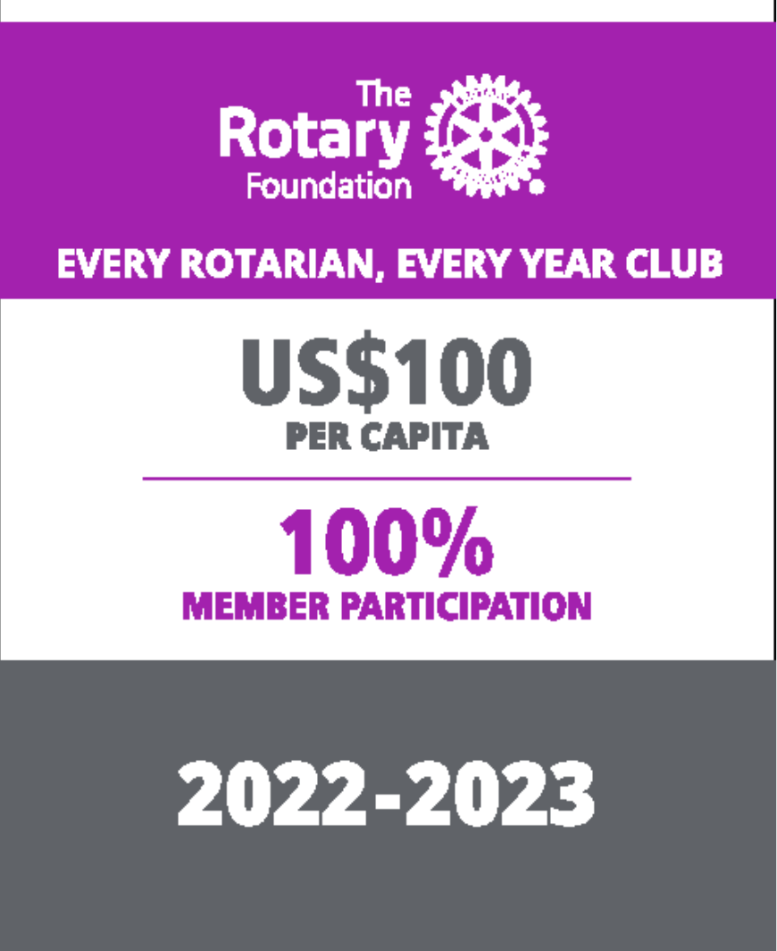


Club Recognition
There are several club Foundation banners that recognize outstanding giving, including:
170
$11.9
100% Foundation Giving Club
Every Rotarian, Every Year Club
100% Paul Harris Fellow Club
100% Paul Harris Society Club
101
$8.9
729
$59.4
189
Notes:
We award Foundation banners to clubs that achieve outstanding giving:
The 100% Foundation Giving Club banner recognizes clubs whose members give an average of $100 to any Foundation fund, with every member contributing at least $25.
The Every Rotarian, Every Year Club banner recognizes clubs whose members give an average of $100 to the Annual Fund, with every member contributing at least $25.
The 100% Paul Harris Society Club banner recognizes clubs whose members each contribute at least $1,000 to the Annual Fund, PolioPlus Fund, or an approved global grant during a given Rotary year.
The 100% Paul Harris Fellow Club banner recognizes clubs whose active members are all Paul Harris Fellows at the time when the district governor requests the banner. This banner can be earned only once.
The 100% Rotary’s Promise Club banner (not shown) is given to clubs in which every dues-paying member supports the Endowment. The support may be a commitment of a future gift in an estate plan or an outright gift of $1,000 or more to the Endowment.
And finally, Rotaract clubs can earn a digital Rotaract Giving Certificate if their members give to the Foundation and the total is at least $100 collectively.
[Recognize any clubs that reached one or more of these achievements last year, and thank their members.]

Slide 15
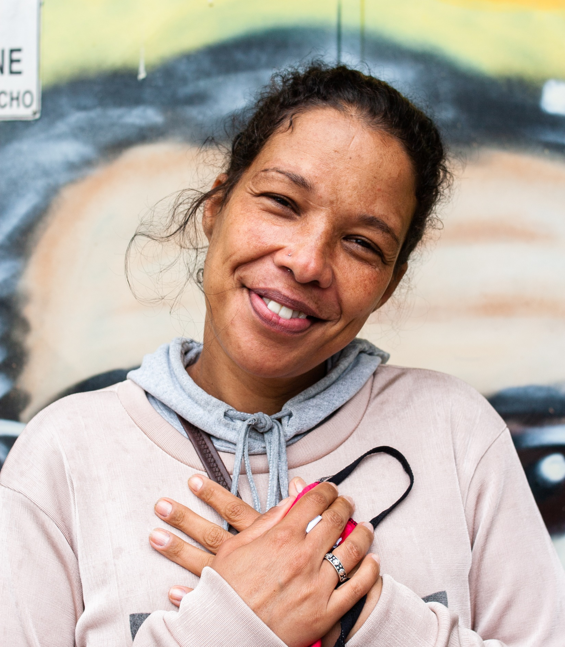
WAYS TO GIVE*
Automate your giving through Rotary Direct
Donate online at rotary.org/donate
Give a check to your club Foundation chair
Mail your gift directly to the Foundation
  The Rotary Foundation
  14280 Collections Center Dr.
  Chicago, IL 60693
Use a gift to honor or remember someone
Increase your impact with corporate matching
Start a fundraiser on Raise for Rotary
Notes:
There are many ways you can make our Foundation your charity of choice.
You can join Rotary Direct, our recurring giving program.
You can give online at rotary.org/donate. If you sign in to My Rotary, your donation will automatically be connected to your account and credited to your club.
You can donate through your club by talking to your Foundation chair.
Or you can mail your gift by using the Foundation contribution form, available on My Rotary.
A donation made in a loved one’s memory is a meaningful memorial, and a donation made in someone’s honor can be a perfect birthday, wedding, or holiday gift. You can make such a gift when you donate through My Rotary.
If your company matches charitable donations, consider having it match yours. Request a matching gift form from your employer, and send the completed and signed form to the Foundation along with your contribution. Write to our Annual Giving staff at annualfund@rotary.org for details.
You can also start a fundraiser to benefit the Rotary Foundation through our new peer-to-peer platform, Raise for Rotary! Visit rotary.org/raise to get started.
*some methods are only available in a portion of countries served

Slide 16
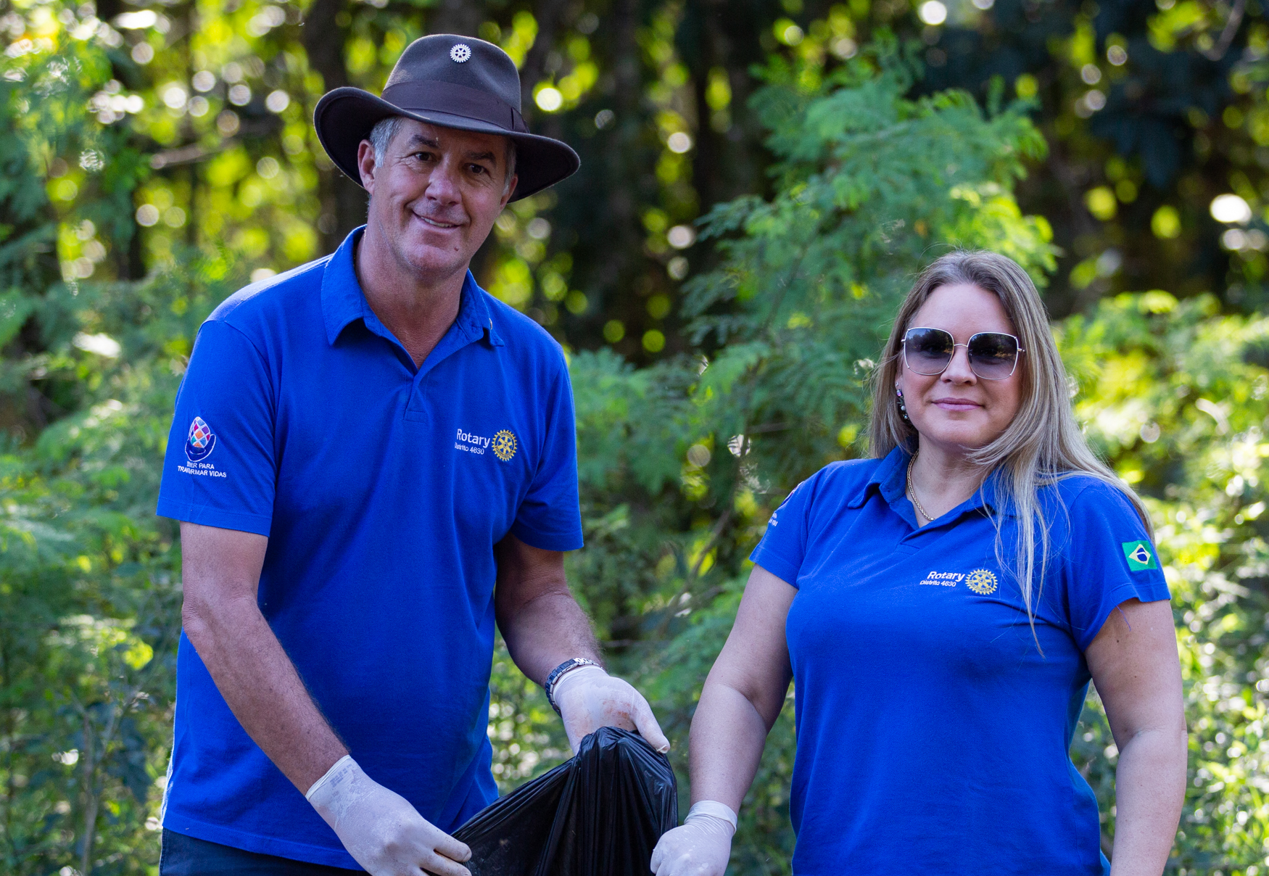
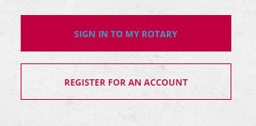

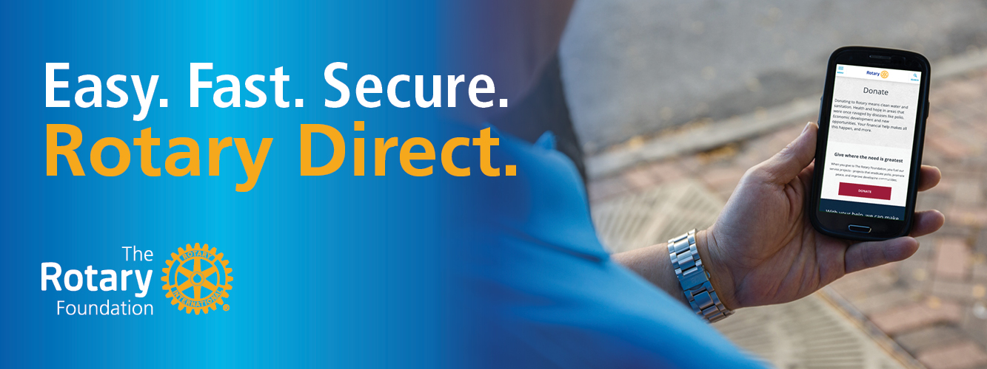
Rotary Direct
It’s easy, fast, and secure.
You can adjust or cancel your recurring gifts anytime through My Rotary.
Visit my.rotary.org/rotary-direct to learn more or enroll.
Notes:
As just mentioned, Rotary Direct is The Rotary Foundation’s recurring giving program. When you enroll in Rotary Direct, giving is easy, fast and secure. You can personalize your giving schedule to accomplish your philanthropic goals and empower Rotary members around the world to change lives. Visit my.rotary.org/rotary-direct to get started.

Slide 17
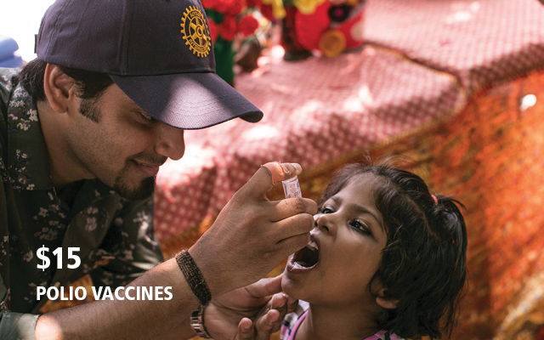


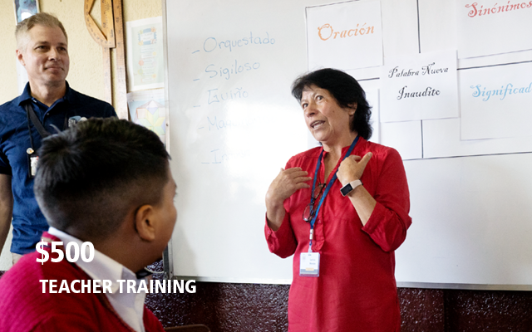

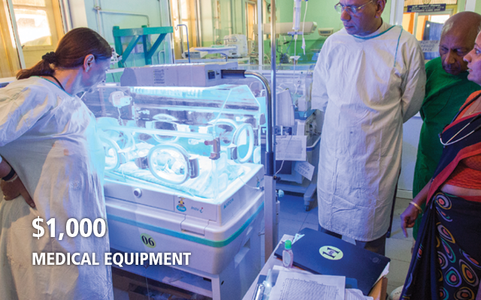
YOUR GIFT AT WORK
Gifts of any size can make a big impact
In Rotary year 2022-23, The Rotary Foundation was able to support 1,098 global grants because of our generous donors.
No matter how you choose to give, your gift will help Rotary members keep Doing Good in the World.
Notes:
No matter how you choose to give, I hope you’ll join me in supporting our Foundation by donating to the Annual Fund this year. Remember, gifts of any size have a big impact when they’re put to use by our Foundation and our network of Rotary Members around the world.

Slide 18
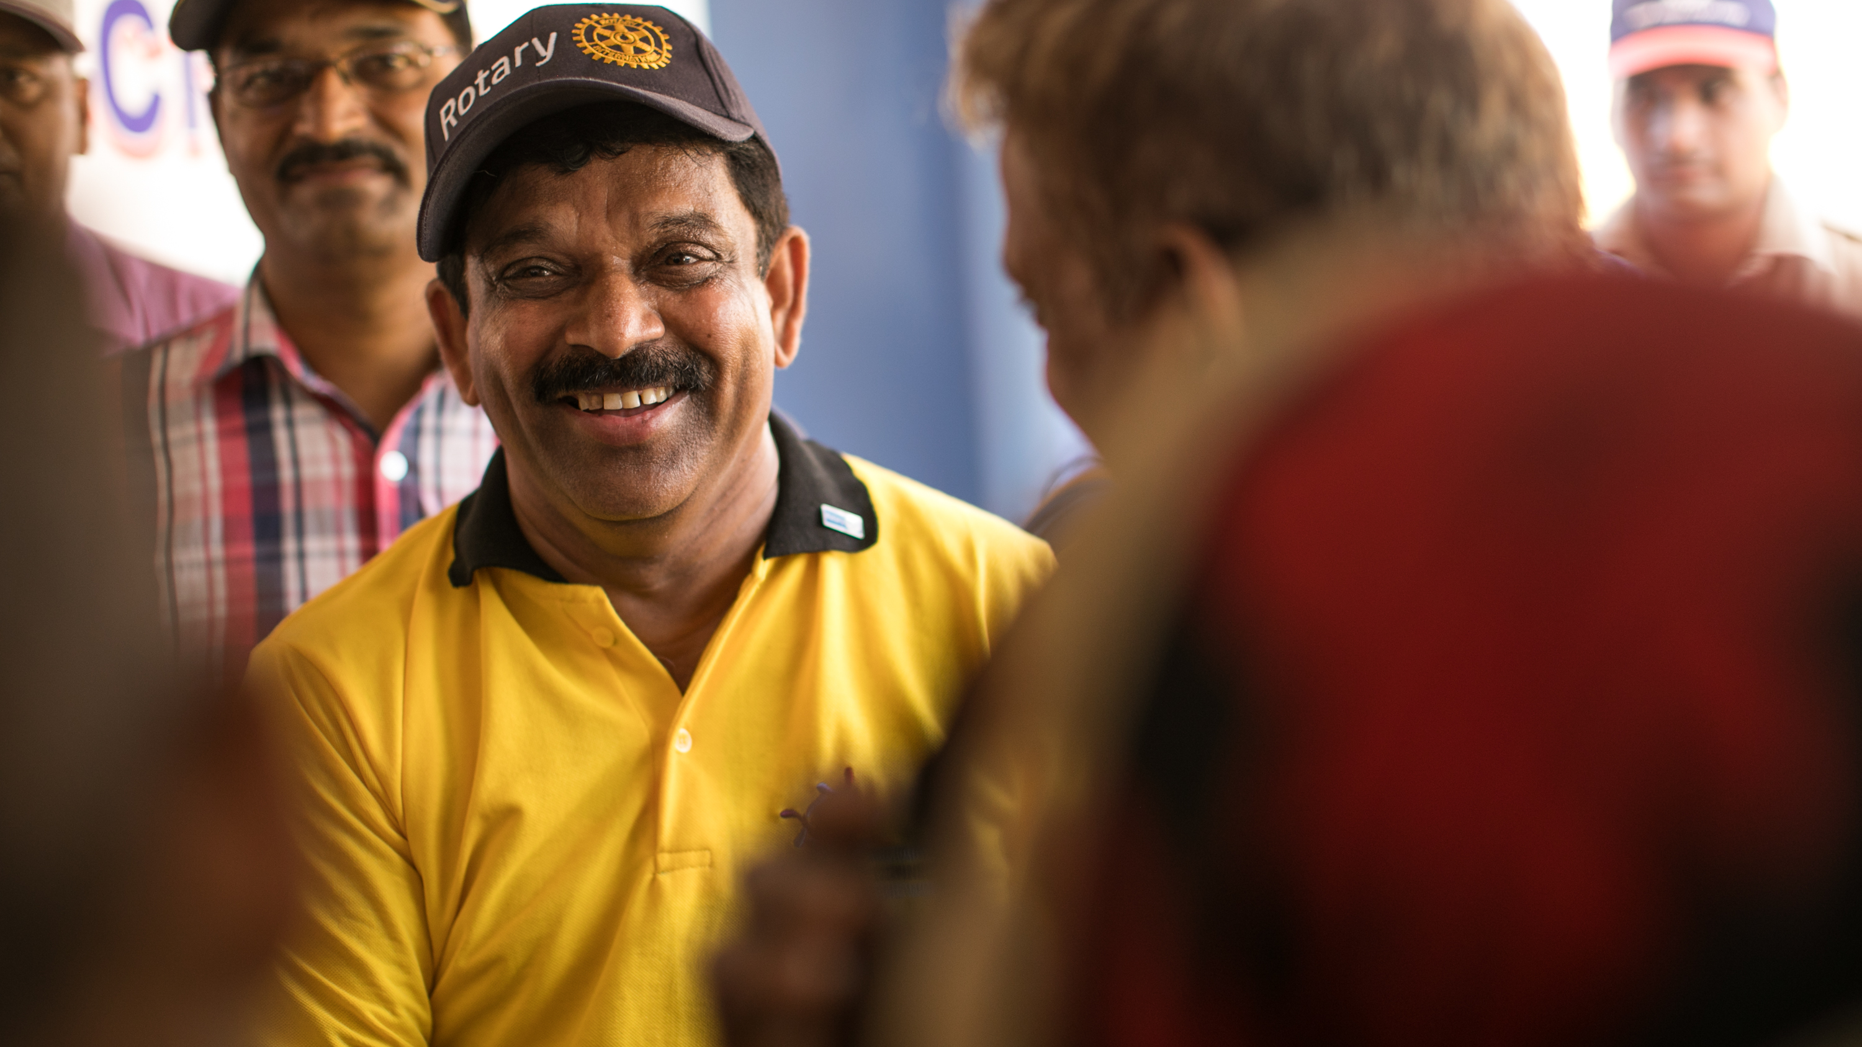
THANK YOU
FOR DOING GOOD IN THE WORLD

Slide 19
QUESTIONS?

